Slide 1
The Chiang Mai Red Taxi Service Assistant
Progress I Presentation
Kanittee Hongron 542115003
Pimchittra Sukkasem 542115042

Slide 2
Agenda
Introduction
Architecture
Progress 1 Report
Software Demo
Mistakes and Problem
Progress 2 Plan
Q&A

Slide 3
Introduction

Slide 4





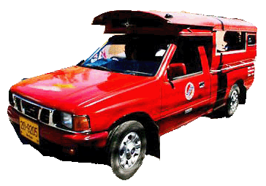

Slide 5
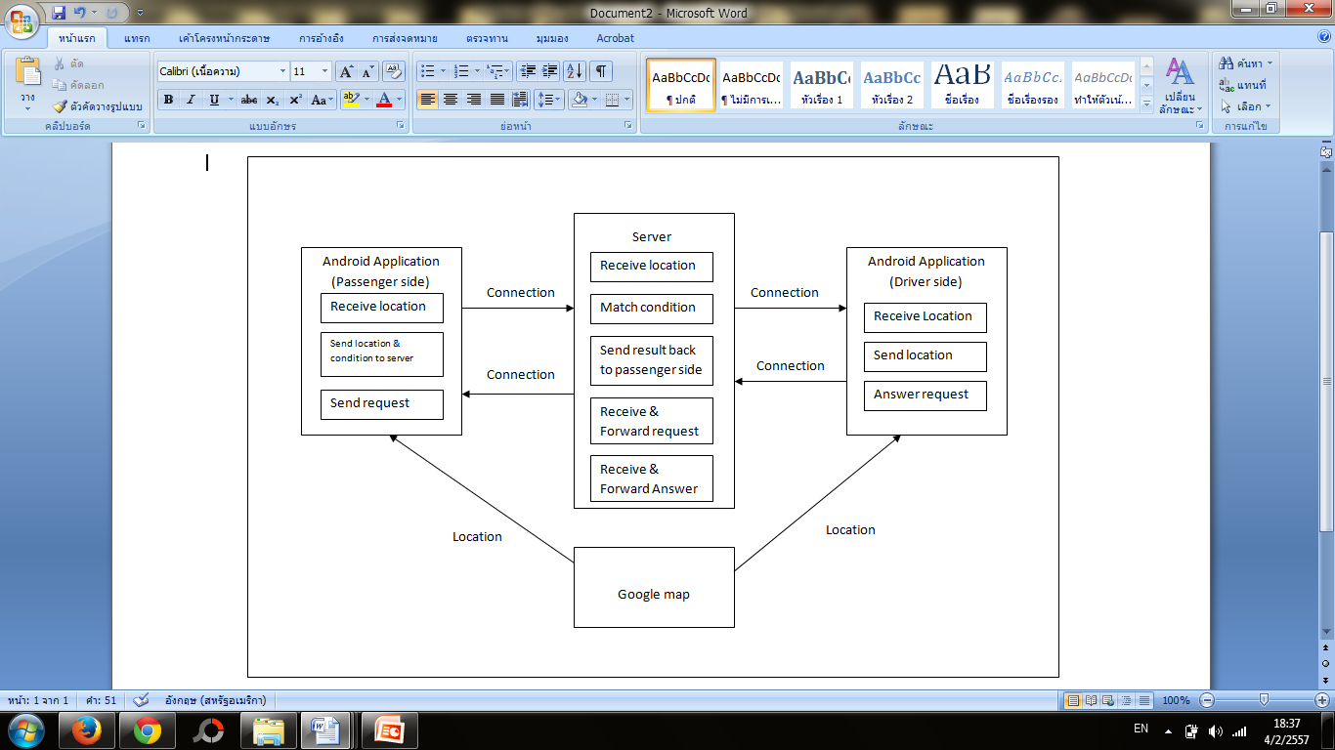
Architecture

Slide 6


User
Chat with Passenger
Chat with Driver
Updates driving info
Via on Server
Search for Red Taxi
Send request
Respond Request
Add, edit , delete destination
Administrator
Passenger
Driver

Slide 7
Progress I Report

Slide 8
Features

Slide 9
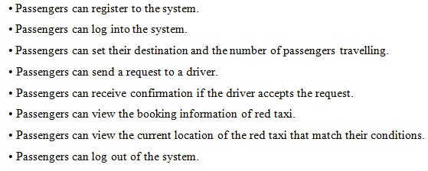
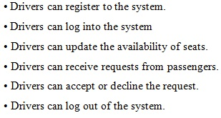
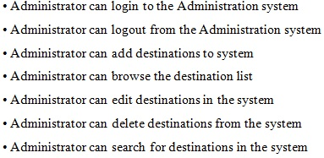
Progress 1

Slide 10
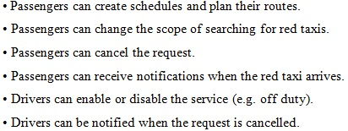
Next Progress

Slide 11
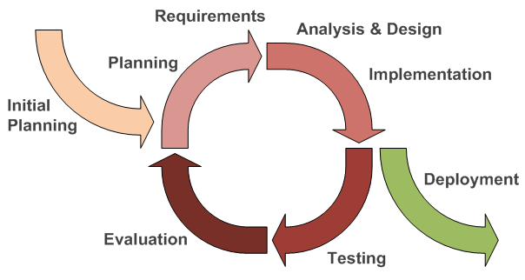
Project Plan

Slide 12
2 w
Project Management Plan
4 w
Software Requirement Specification
5 w
Software Design Document
20 w
Implementation
10 w
Test Plan & Test Record
3 d
Traceability Record

Slide 13

Repository
Proposal
Project Plan
SRS
Software Design
Test
Traceability Record
Source Code
Others

Slide 14
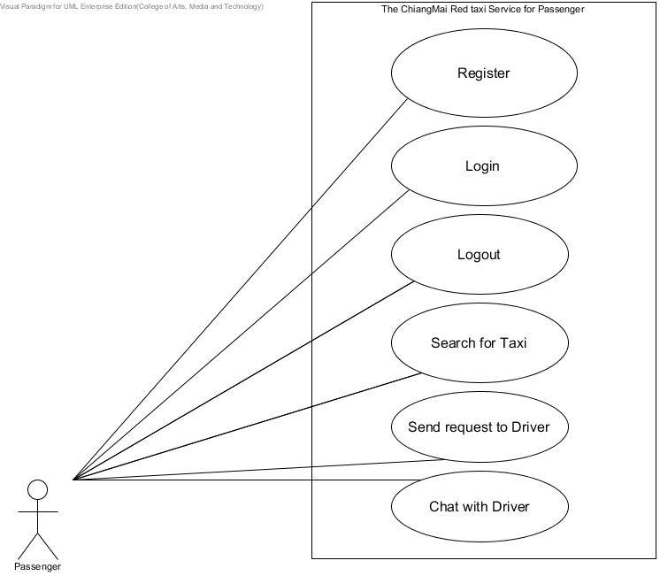
Use Case - Passenger

Slide 15
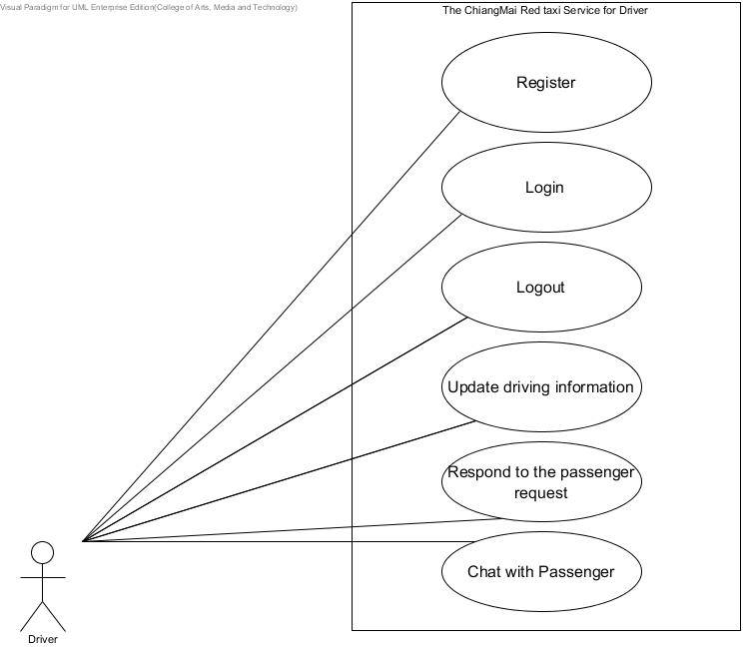
Use Case - Driver

Slide 16
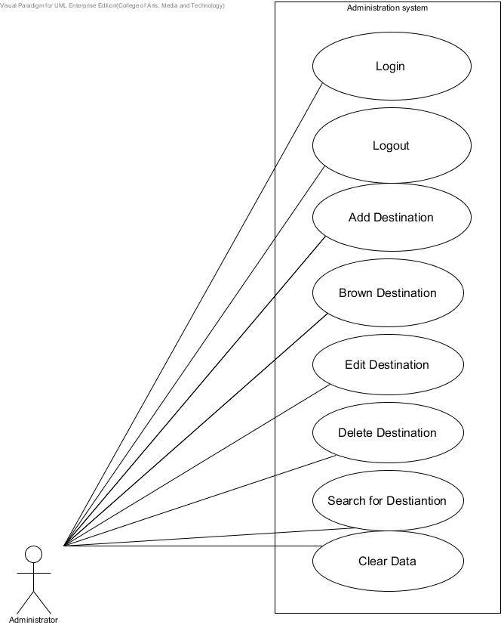
Use Case - Administrator

Slide 17
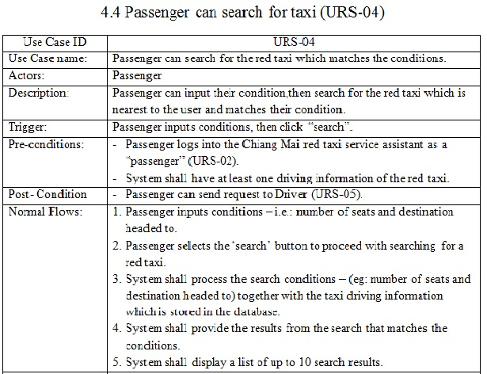
Use Case Description

Slide 18
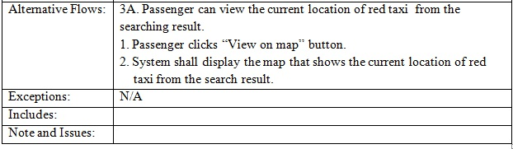

Slide 19
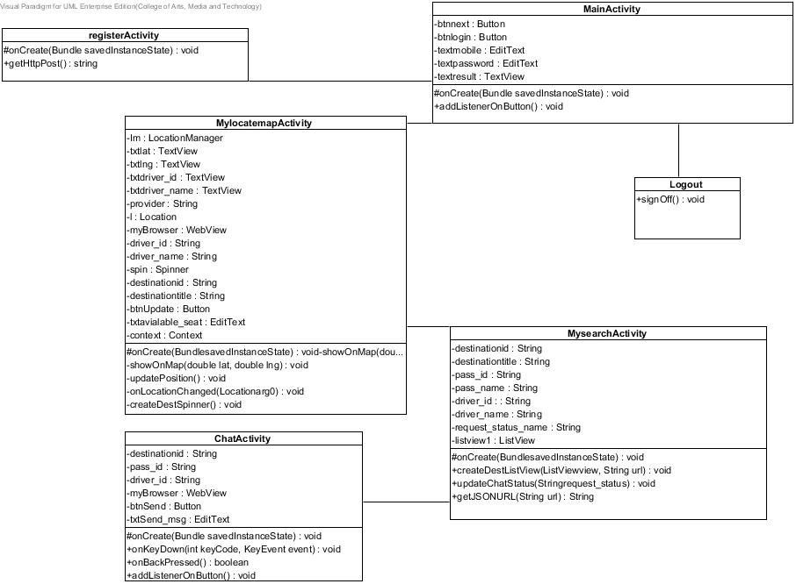
Class Diagram Passenger’s side

Slide 20
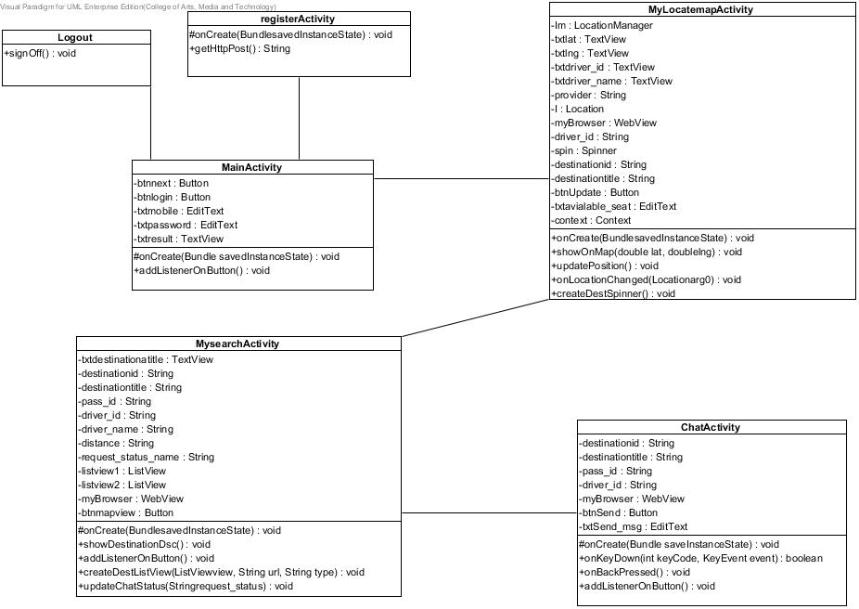
Class Diagram Passenger’s side

Slide 21
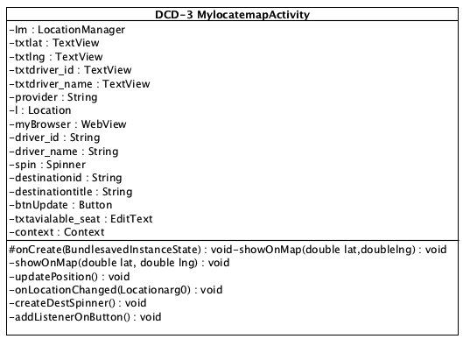
Class Diagram Description

Slide 22
Attributes
ID | Name | Description | Data Type
1 | Lm | Set the location and connect to google map | LocationManager
2 | txtlat | Set latitude | TextView
3 | txtlng | Set longutude | TextView
4 | txtdriver_id | Textfield to put driver’s id | TextView
5 | txtdriver_name | Textfield to put driver’s name | TextView
6 | provider | Set and get map | String
7 | L | Location | Location
8 | myBrowser | Find map | Webview
9 | driver_id | Driver’s id | String
10 | driver_name | Driver’s name | String
11 | Spin | Special attribute for spinner method | Spinner
12 | destinationid | Set destination id | String
13 | destinationtitle | Set destination target | String
14 | btnUpdate | Button action update destination | Button
15 | txtavialable_seat | Textfield set available seat | EditText
16 | context | Set context | Context

Slide 23
Methods
ID | Name | Description | Parameters | Return
1 | #onCreate | Open action on android | Bundle savedInstanceState | void
2 | showOnMap | Show point on map | double lat, double lng | void
3 | updatePosition | Map update | - | void
4 | onLocationChanged | Map point location update | Location arg0 | void
5 | createDestSpinner | Method with show map destination on android | - | void
6 | addListenerOnButton | Run an action in andriod | - | void

Slide 24
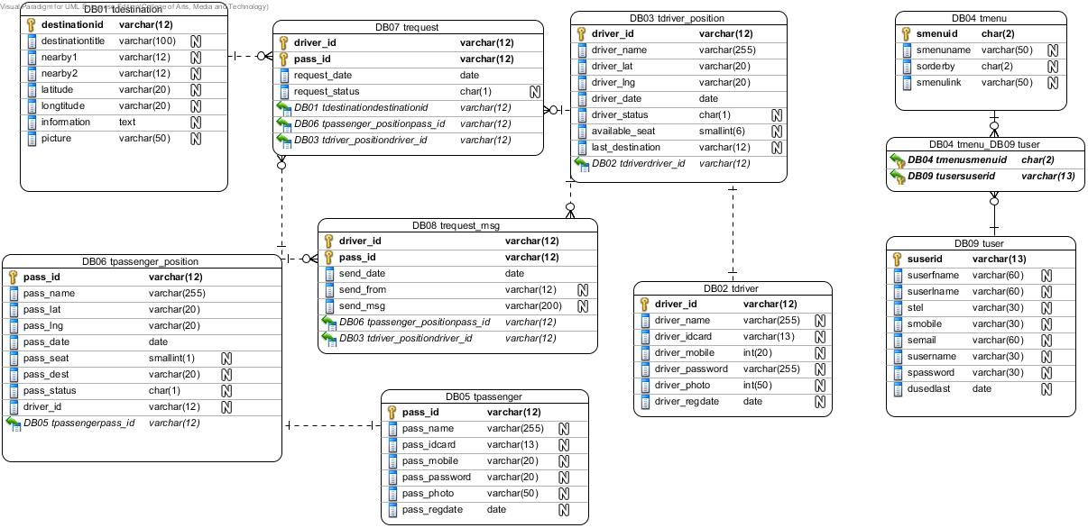
Database Design

Slide 25
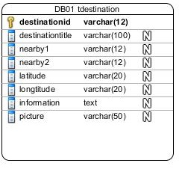
Database Description

Slide 26
Field Name | Data type | Length | PK/FK | Null able | Description
destinationid | varchar | 12 | PK | Not Null | This variable is declared as an identification number of each destination. (e.g. 140510043030)
destinationtitle | varchar | 100 | - | Not Null | This variable is for the title of the destination. (e.g. Thaphae Gate)
nearby1 | varchar | 12 | - | Not Null | This variable is for represent the destination ID of one of two places that located near by the destination. (e.g. 140519040517)
nearby2 | varchar | 12 | - | Not Null | This variable is used to represent the destination ID of one of two places that located near by the destination. (e.g. 14051905032)
latitude | varchar | 20 | - | Not Null | This variable is used to describe the latitude value of a destination. (e.g. 18.78801743704621)
longtitude | varchar | 20 | - | Not Null | This variable is used to describe the longitude value of a destination. (e.g. 98.9937686920166)
information | text | - | - | Not Null | This variable is used to describe the information about the destination.
picture | varchar | 50 | - | Not Null | This variable is used to name the image file. Numeric digits and alphabets can be used. (e.g. 1309799402.jpg)

Slide 27
Example URS and SRS
Passenger can search for taxi (URS-04)
SRS-16 System shall display the map that shows the current location of red taxi from the search result.
SRS-17 System shall process the search conditions – (eg: number of seats and destination headed to) together with the taxi driving information which is stored in the database.
SRS-18 System shall provide the results from the search that matches the conditions.
SRS-19 System shall display a list of up to 10 search results.

Slide 28
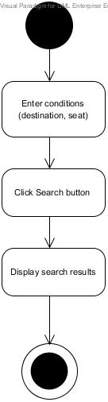
Passenger can search for taxi (URS-04)

Slide 29
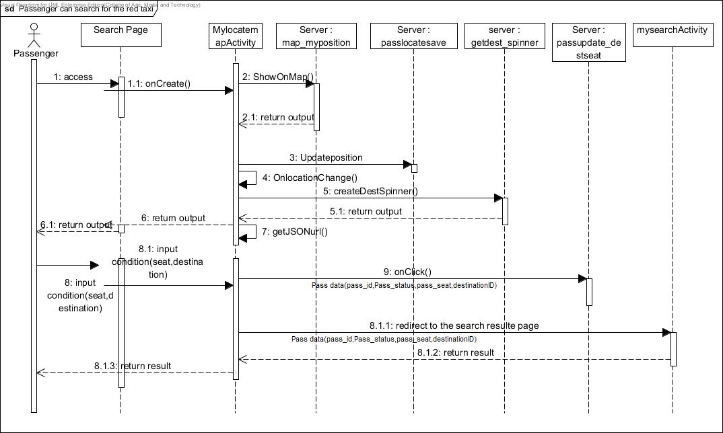
Sequence Diagram
Passenger can search for taxi (URS-04)

Slide 30
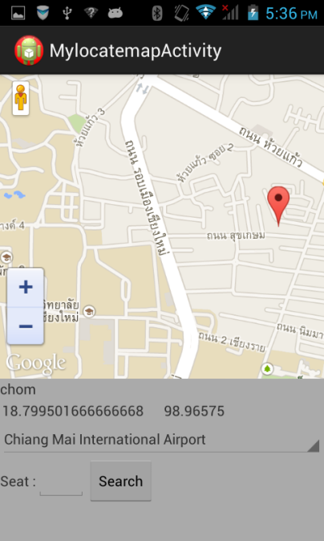
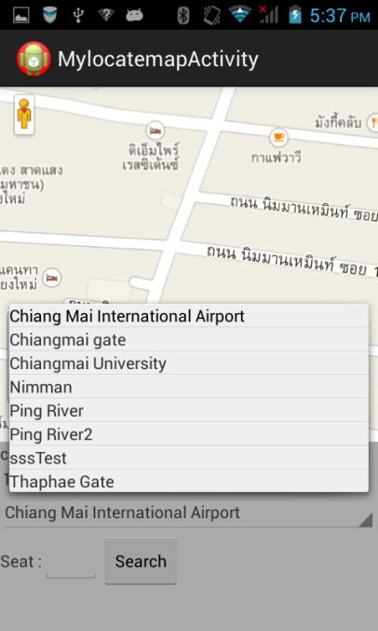
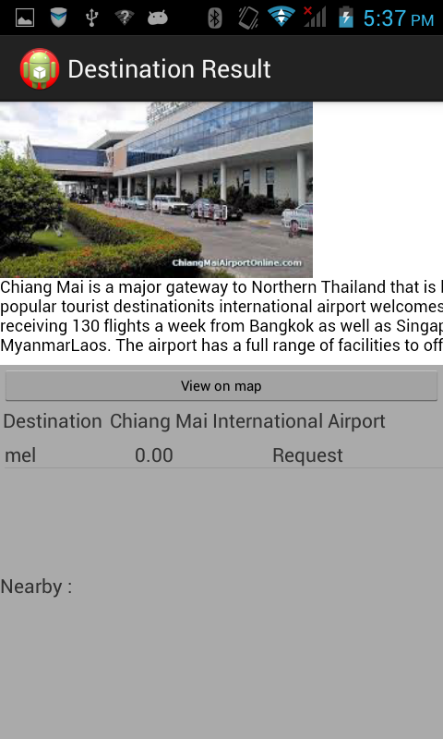
User Interface Design
Passenger can search for taxi (URS-04)

Slide 31
Limits
The application requires an Internet connection.
The application can only be used on Android smartphones that run on Android OS 4.0 or later.
The application cannot be supported on an Android tablet.
Drivers have to preset a general direction of driving using their mobile application before leaving.
Only passengers can send a request to drivers (one driver per request).

Slide 32
Limits
Drivers cannot locate passengers unless there is a request from them.
Services are limited to the passengers and drivers in Chiang Mai only.
Services are limited to the registered taxis and passengers only.
(Registration is required before using the application.)

Slide 33
Software Demo

Slide 34
Mistakes and Problems

Slide 35


Testing
We need to improve our testing.

Slide 36

Misunderstanding
When update something and everything need to be updated.
So, it cause a lot of mistakes

Slide 37
Progress 2 Plan

Slide 38
Continue improving progress I testing
Improve User Interfaces
Continue developing sub features
• Passengers can create schedules and plan their routes.
• Passengers can change the scope of searching for red taxis.
• Passengers can cancel the request.
• Passengers can receive notifications when the red taxi arrives.
• Drivers can enable or disable the service (e.g. off duty).
• Drivers can be notified when the request is cancelled.

Slide 39
Q & A

